Slide 1
$natural Operator Sorting
The ({$natural : − 1}) works like LIFO(LAST IN FIRST OUT), that means last inserted document will be shown first.

Slide 2
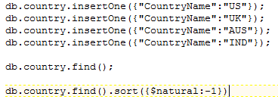
$natural Operator Sorting

